Slide 1
13637 - Easy Gomoku Validator
I2P mid practice

Slide 2
Description
Given N lines of board placement, where x & y represent the stone position of each round (x_{2i-1} & y_{2i-1} for Black; x_{2i} & y_{2i} for White). Note that all index used in this problem are 1-based.
Output if there is a winner or not.
Winner: an unbroken chain of five stones horizontally, vertically, or diagonally

Slide 3
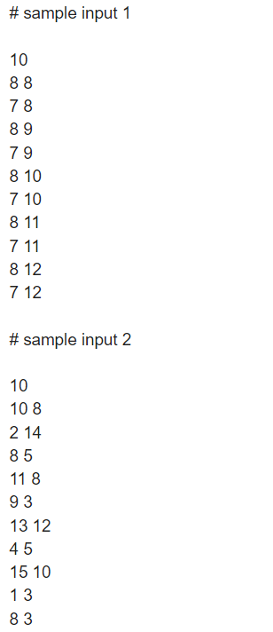
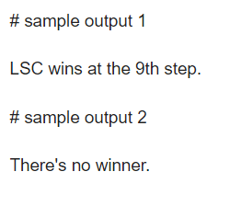

Slide 4
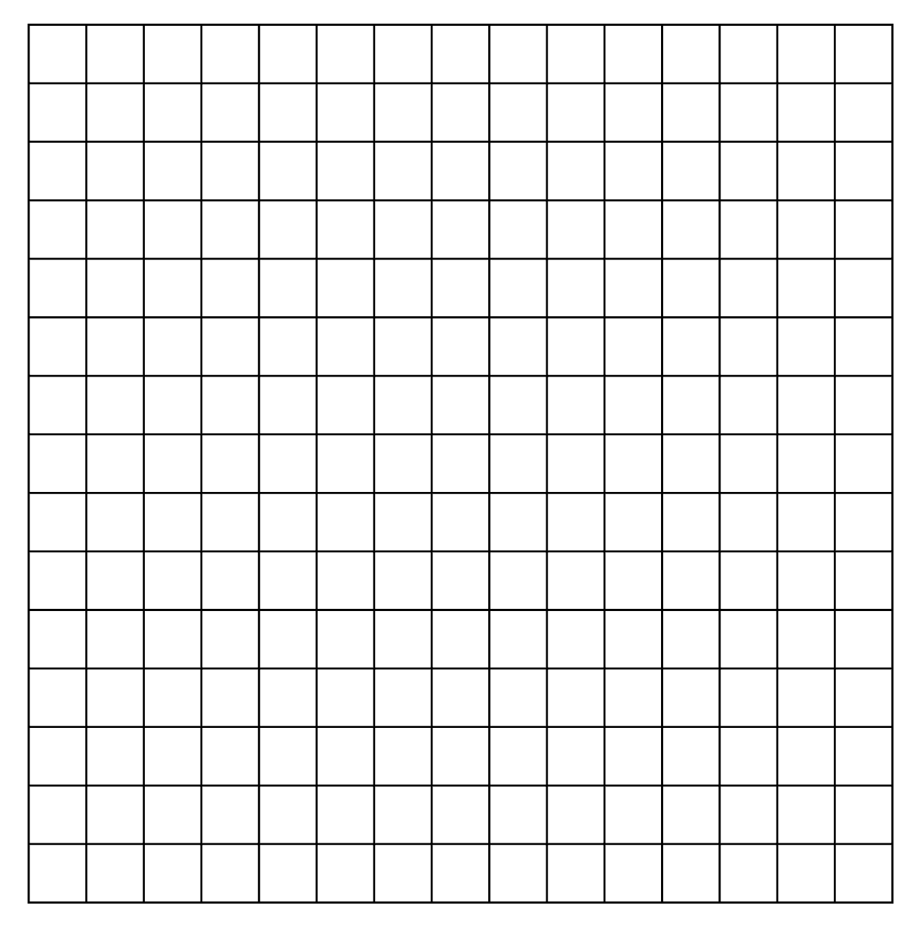
Winner: an unbroken chain of five stones horizontally, vertically, or diagonally

Slide 5
Idea – 2D board array
Declare a 2D array allowing to let us start from 1
Player Black as 1
Player White as 2
No player as 0
=> int board[15+1][15+1];

Slide 6
Idea – Take Vertical Line as Example
(15, 15)
Assume we are player Black
Next stone is red border one
How do we check whether there is a line of 5 stones?
(1, 1)

Slide 7
Idea – Take Vertical Line as Example
(15, 15)
Assume we are checking direction up
3 Conditions to keep checking: position_x >= 1 && position_x < 16 && position_y >= 1 && position_y < 16 && board[position_x][position_y] == player
?
?
?
?
(x, y)
(1, 1)

Slide 8
(15, 15)
Assume we are checking direction up
3 Conditions to keep checking: position_x >= 1 && position_x < 16 && position_y >= 1 && position_y < 16 && board[position_x][position_y] == player
?
?
?
?
?
(x, y)
(1, 1)

Slide 9
(15, 15)
Assume we are checking direction up
3 Conditions to keep checking: position_x >= 1 && position_x < 16 && position_y >= 1 && position_y < 16 && board[position_x][position_y] == player
(x, y) fulfilled 3 conditions => keep checking next stone (x, y+1)
?
?
?
(x, y + 1)
?
V
(x, y)
(1, 1)

Slide 10
(15, 15)
Assume we are checking direction up
3 Conditions to keep checking: position_x >= 1 && position_x < 16 && position_y >= 1 && position_y < 16 && board[position_x][position_y] == player
?
?
?
(x, y + 1)
?
V
(x, y)
(1, 1)

Slide 11
(15, 15)
Assume we are checking direction up
3 Conditions to keep checking: position_x >= 1 && position_x < 16 && position_y >= 1 && position_y < 16 && board[position_x][position_y] == player
(x, y+1) fulfilled 3 conditions => keep checking next stone (x, y+2)
?
?
(x, y + 2)
?
(x, y + 1)
V
V
(x, y)
(1, 1)

Slide 12
(15, 15)
Assume we are checking direction up
3 Conditions to keep checking: position_x >= 1 && position_x < 16 && position_y >= 1 && position_y < 16 && board[position_x][position_y] == player
?
?
(x, y + 2)
?
(x, y + 1)
V
V
(x, y)
(1, 1)

Slide 13
(15, 15)
Assume we are checking direction up
3 Conditions to keep checking: position_x >= 1 && position_x < 16 && position_y >= 1 && position_y < 16 && board[position_x][position_y] == player
(x, y+2) fulfilled 3 conditions => keep checking next stone (x, y+3)
?
(x, y + 3)
?
(x, y + 2)
V
(x, y + 1)
V
V
(x, y)
(1, 1)

Slide 14
(15, 15)
Assume we are checking direction up
3 Conditions to keep checking: position_x >= 1 && position_x < 16 && position_y >= 1 && position_y < 16 && board[position_x][position_y] == player
?
(x, y + 3)
?
(x, y + 2)
V
(x, y + 1)
V
V
(x, y)
(1, 1)

Slide 15
(15, 15)
Assume we are checking direction up
3 Conditions to keep checking: position_x >= 1 && position_x < 16 && position_y >= 1 && position_y < 16 && board[position_x][position_y] == player
(x, y+3) fulfilled 3 conditions => keep checking next stone (x, y+4)
(x, y + 4)
?
(x, y + 3)
V
(x, y + 2)
V
(x, y + 1)
V
V
(x, y)
(1, 1)

Slide 16
(15, 15)
Assume we are checking direction up
3 Conditions to keep checking: position_x >= 1 && position_x < 16 && position_y >= 1 && position_y < 16 && board[position_x][position_y] == player
(x, y + 4)
?
(x, y + 3)
V
(x, y + 2)
V
(x, y + 1)
V
V
(x, y)
(1, 1)

Slide 17
(15, 15)
Assume we are checking direction up
3 Conditions to keep checking: position_x >= 1 && position_x < 16 && position_y >= 1 && position_y < 16 && board[position_x][position_y] == player
(x, y+4) fulfilled 3 conditions => keep checking next stone (x, y+5)
(x, y + 4)
V
(x, y + 3)
V
(x, y + 2)
V
(x, y + 1)
V
V
(x, y)
(1, 1)

Slide 18
(15, 15)
Assume we are checking direction up
3 Conditions to keep checking: position_x >= 1 && position_x < 16 && position_y >= 1 && position_y < 16 && board[position_x][position_y] == player
(x, y+4) fulfilled 3 conditions => keep checking next stone (x, y+5) => not fulfilled => 5 stones in line
(x, y + 4)
V
(x, y + 3)
V
(x, y + 2)
V
(x, y + 1)
V
V
(x, y)
(1, 1)

Slide 19
(15, 15)
However, we have troubles for the “middle” cases
We should actually check both directions => Top & Down => Left & Right => Diagonally \ => Diagonally /
If Two directions (including self stone) >= 5 => We found a line.
(x, y + 2)
V
(x, y + 1)
V
(x, y)
V
(x, y - 1)
V
V
(x, y - 2)
(1, 1)

Slide 20
NConsecutiveStones: return # of consecutive stones)
int directiontable[8][2] = {{0,1},{0,-1},{-1,0},{1,0},{-1,1},{1,-1},{1,1},{-1,-1}};
int NConsecutiveStones (int position_x, int position_y, int player, int direction) {
int nCS = 0; //the number of consecutive stones
while( position_x >= 1 && position_x < 16 && position_y >= 1 && position_y < 16 && board[position_x][position_y] == player
) {
nCS++;
position_x += directiontable[direction][0];
position_y += directiontable[direction][1];
}
return nCS;
}
3 conditions

Slide 21
Checker: return 1 if a line of at least five stones in a dir. pair
int directiontable[8][2] = {{0,1},{0,-1},{-1,0},{1,0},{-1,1},{1,-1},{1,1},{-1,-1}};
int Checker (int position_x, int position_y, int player, int round) {
int found = 0;//a flag
int direction_pair;
for(direction_pair = 0; direction_pair < 4; direction_pair++) {
int nCS_total = 0; //the total number of consecutive stones
nCS_total = NConsecutiveStones(position_x, position_y, player, 2*direction_pair)
+ NConsecutiveStones(position_x, position_y, player, 2*direction_pair+1)-1;
if(nCS_total >= 5) {
Print_if_has_winner(player, round);
found = 1; break;
}
}
return found;
}
Since NConsecutiveStones starts from (x, y), we need to deduct the duplicate self stone.

Slide 22
Print_if_has_winner: Print if has winner
void Print_if_has_winner(int player, int round) {
if (player == first) {
printf("LSC wins at the %dth step.\n", round + 1);
} else {
printf("TSC wins at the %dth step.\n", round + 1);
}
}

Slide 23
The Main function
#define first 1
#define second 2
int main () {
int N = 0; int winner = -1; int i, j; scanf("%d", &N);
for (i = 0; i < N; i++) { // read stone place int player = -1; int place_x = -1, place_y = -1; scanf("%d%d", &place_x, &place_y); if (i % 2 == 0) // black board[place_x][place_y] = player = first; else //white board[place_x][place_y] = player = second; if(Checker(place_x, place_y, player, i)) { winner = player; break; } } if (winner == -1) {printf("There's no winner.\n");} return 0; }
Even round: Black Odd round: White
Check if (x, y) has a line or not

